Slide 1
PWM Drawer
AMIT GRADUATION PROJECT

Slide 2
components
1-Micro controller
2-Graphical LCD

Slide 3
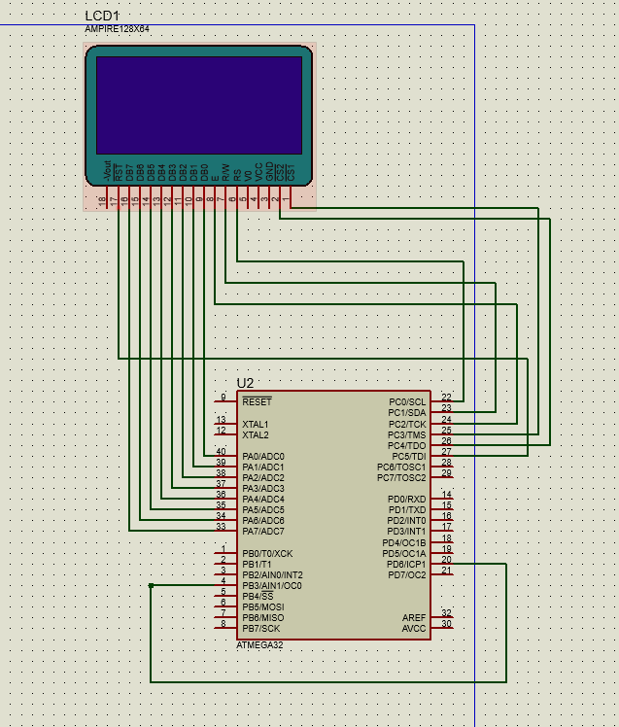
Micro controller connections

Slide 4
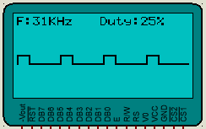
Working Example
The first line we have the frequency and the percentage of the duty cycle.
In the middle we have a graphical representation of PWM

Slide 5
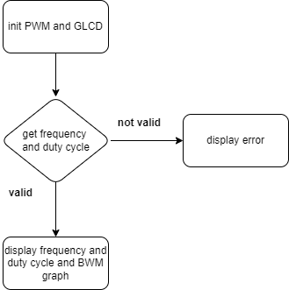
Flow chart
We first start with initializing the graphical LCD and the PWM signal from inside the controller.
Then we wait for the signal and get its frequency and duty cycle.
We then check if their values are valid
If they are not valid, we display an error for the user.
If they are valid, we continue the program and display them and draw the BWM graph.

Slide 6

End any Questions

